Slide 1
Growing into the Future

Slide 2


18 years of experience in IT industry
Had served the Top 500 multinational companies for many years, expertise in business analysis and consulting services
Implemented the Online Transaction and Financial Supply Chain Platform in year 2000
WebCenter Certified Trainer
UBP Coordinator
[
]
UnFranchise™ Business • HK

Slide 3
Technology Professional

Slide 4


Reality

Slide 5


TRADITIONAL 45 YEAR PLAN
95 PERCENT OF PEOPLE SPEND UP TO 45 YEARS OF THEIR LIVES MAKING THE OTHER 5 PERCENT SUCCESSFUL
THEY WORK A PLAN FOR SOMEONE ELSE’S FINANCIAL SUCCESS – NOT THEIR OWN
5%
95%
FINANCIALLY FIT
STRUGGLING FINANCIALLY

Slide 6


現實

Slide 7
shop.com

Slide 8


Slide 11
Less investment, low risk, can even work part-time

Slide 12


Believe
Persistence
Action
Adjustment

Slide 14


Slide 15
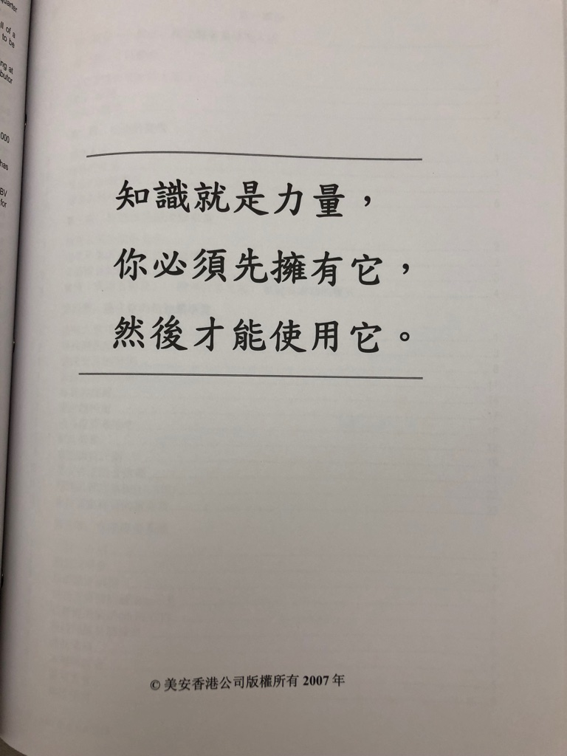


Slide 16








Compounding efforts
Encourages teamwork
and support
Everyone receives 100% credit for sales
and volume generated
ALL IN COMPETITION
Real Estate, Insurance, Franchise, Regional Sales/Manager
Notes:
16

Slide 18
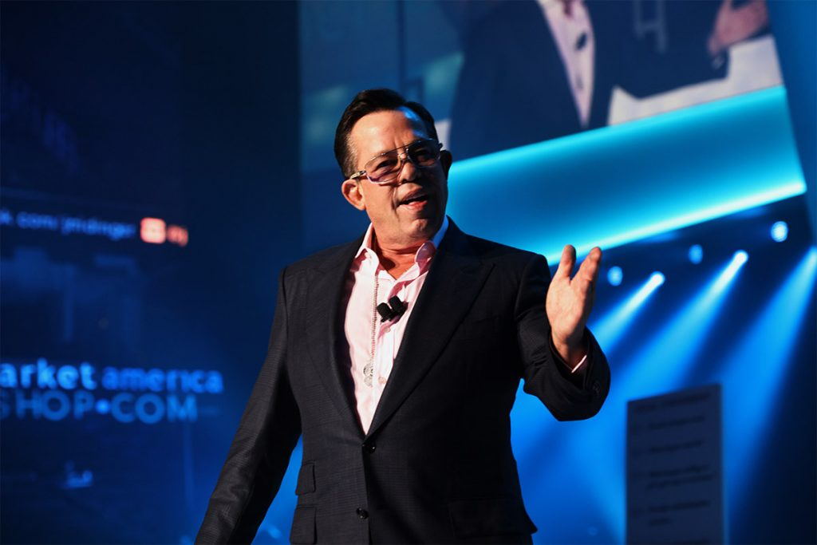
Start your business

Slide 19

  Start your business

Slide 20
  Start your business

Slide 21
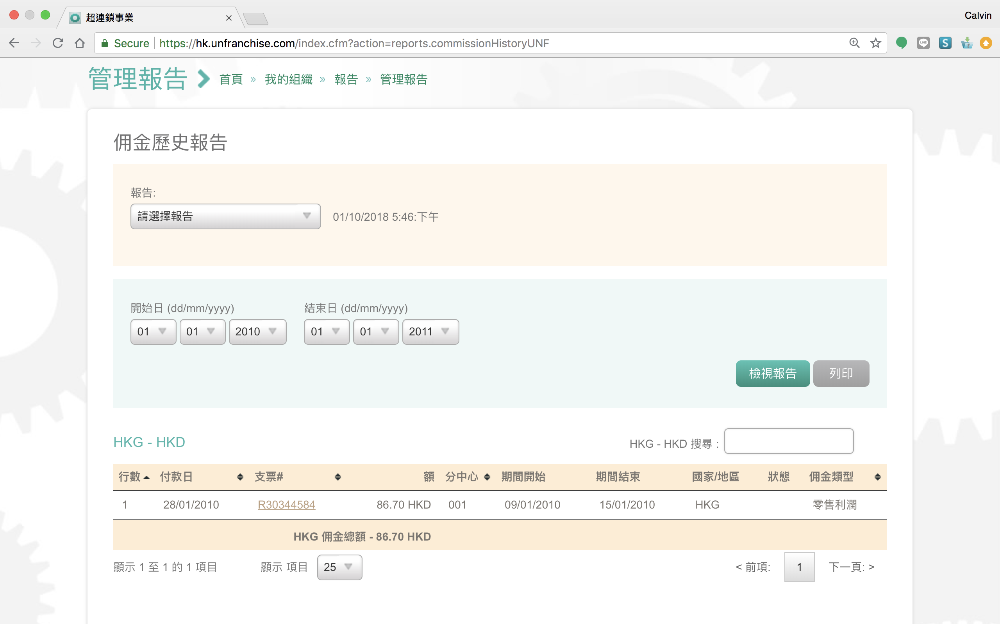

第一年的佣金

Slide 22
Vision

Slide 23
…it will happen whether we take part or not
  Trend

Slide 25
“Type a quote here.”
–Johnny Appleseed

Slide 26


Slide 27

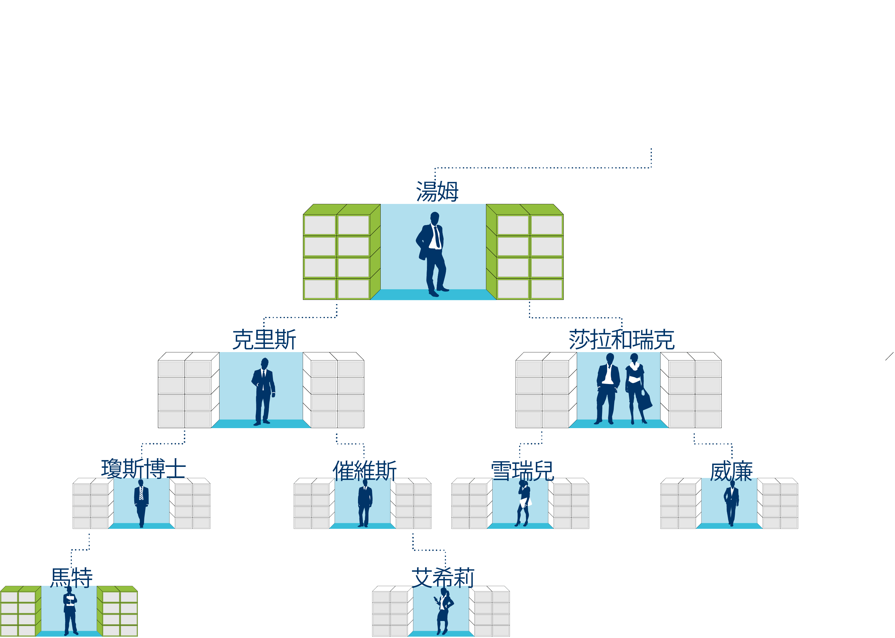
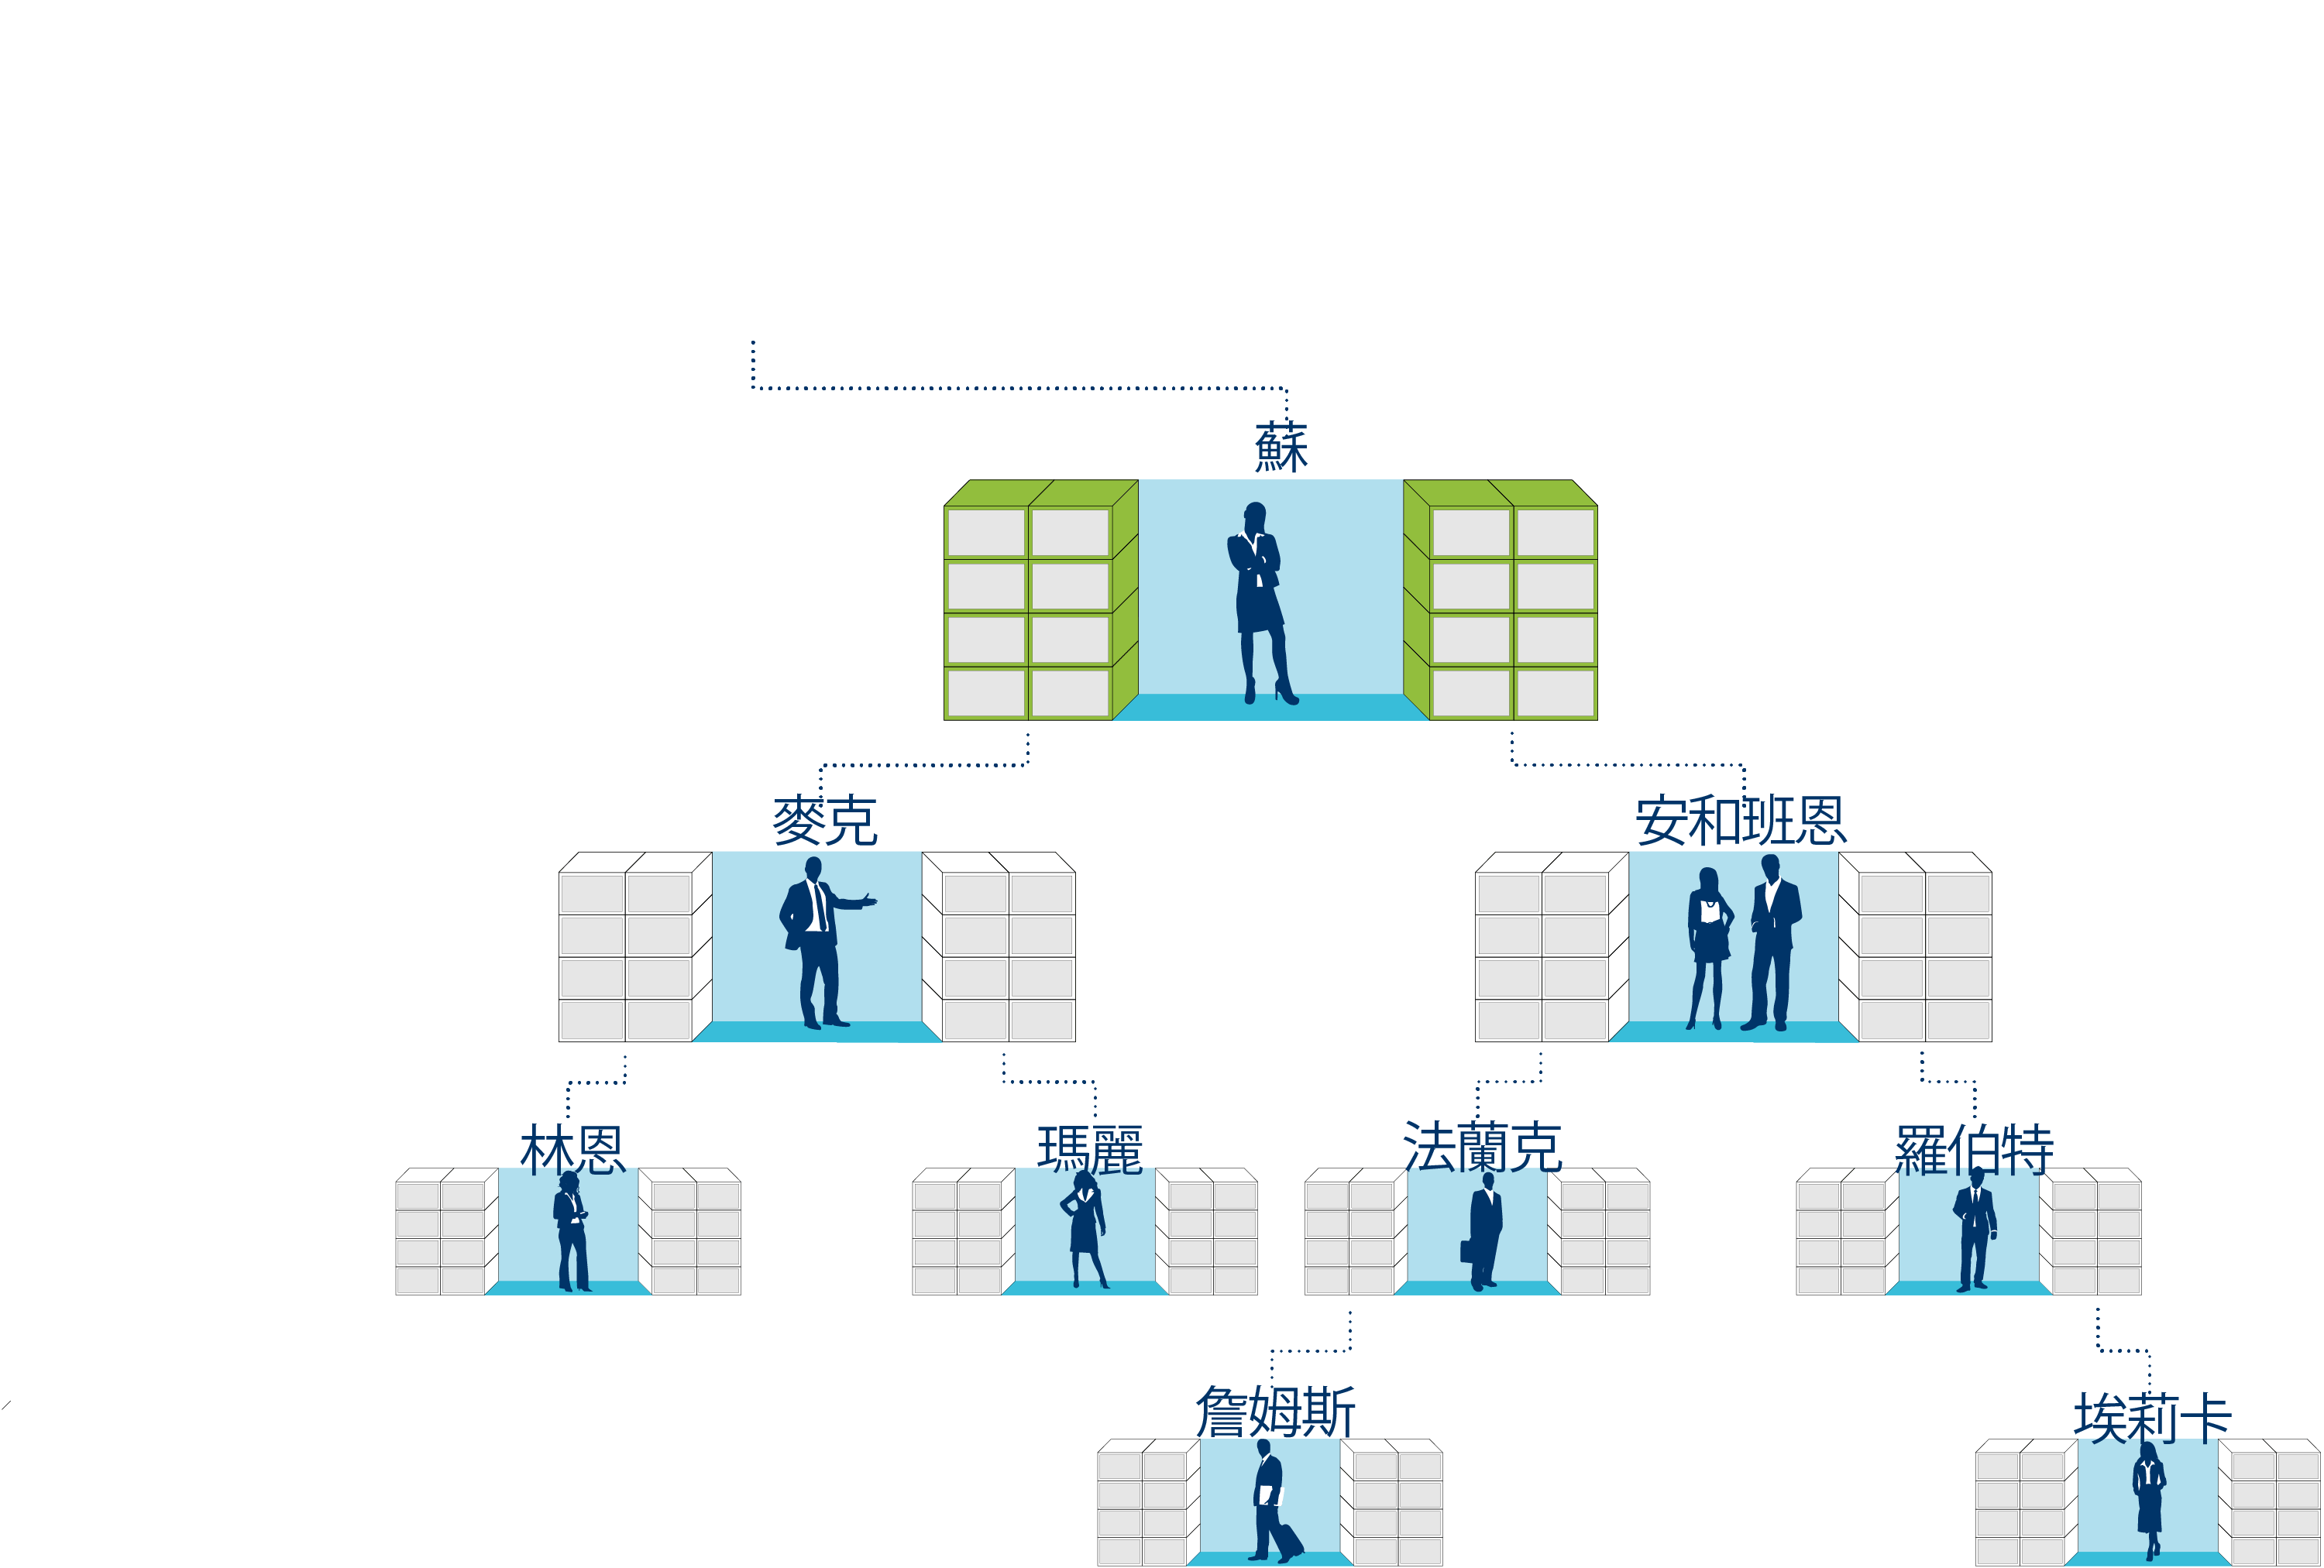

Slide 30
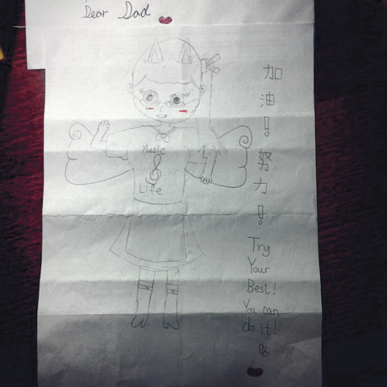

Slide 32
Bring the power from this meeting to the next meeting
Business
knowledge
Understanding of
the company
Goal
Belief
Business skill
This is LOVE!
Direction
Testimonial
Product information
Self-improvement

Slide 33
Team Partners
宗豪， Stanley，
宗昇， Patrick， Linda
SMC
HKD23000/4wks
育莉
Wayne， Vicky， 韋儀
嘉珮 , 畯富
PC
HKD34500/4wks
Jerry, Pricilla
Ruth， Fanny
SC
HKD57500/4wks
Shirley, Vincent
Felix
NSC
HKD76600/4wks
Ann, 京雄
Marcus

Slide 34


